Slide 1
Kick-Off Autonomous Vehicles: Learning and Simulation for Safe & Robust Behavior
Prof. Dr. Holger Giese
Christian Adriano (Chris)
He Xu
System Analysis and Modeling Group
Our contact: first-name.last-name@hpi.de

Slide 2
Agenda
1- Introductions and share each person's expectations
2- Agree on a meeting schedule
3- Review the project goals 4- Discuss needs for intro lectures
5- Overview of the project infrastructure and communication plan
6- Overview of the communication plan 7- Kick-start the risks planning - probability, impact, mitigation 8- Discuss the execution plan
9- Next tasks

Slide 3
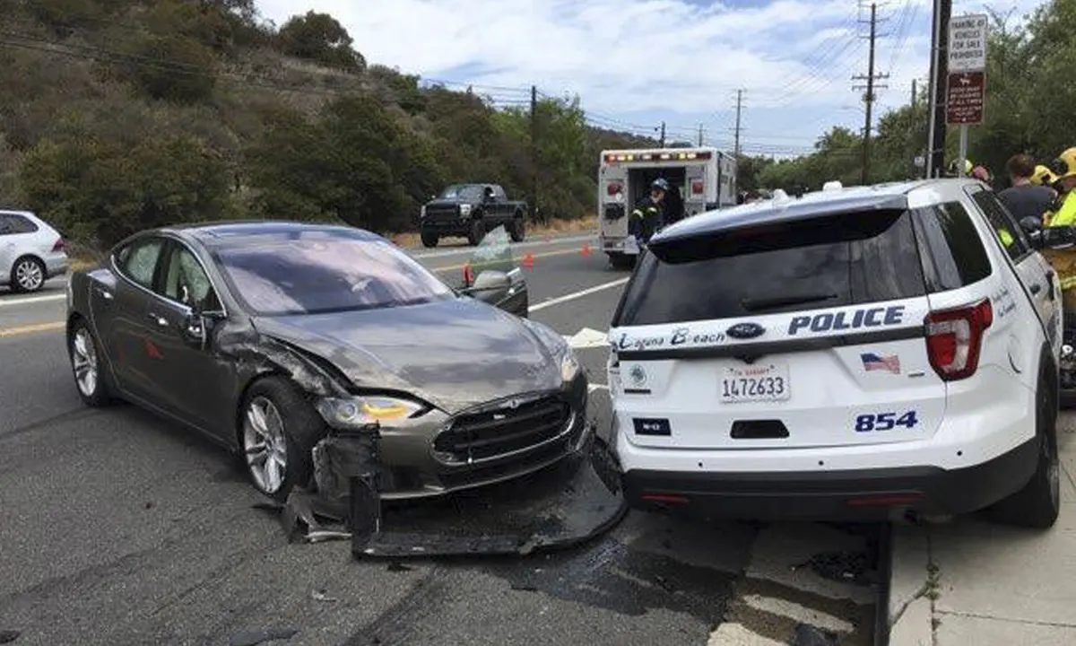
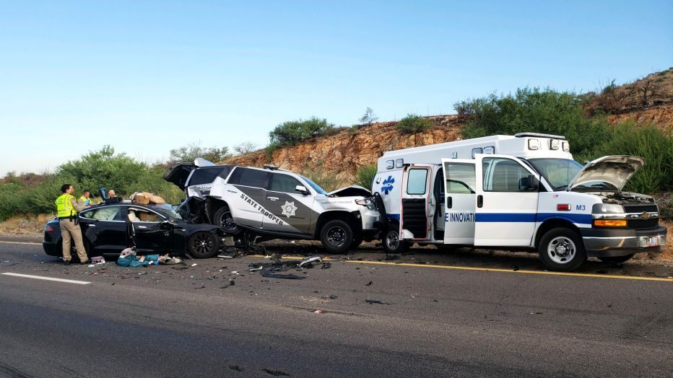
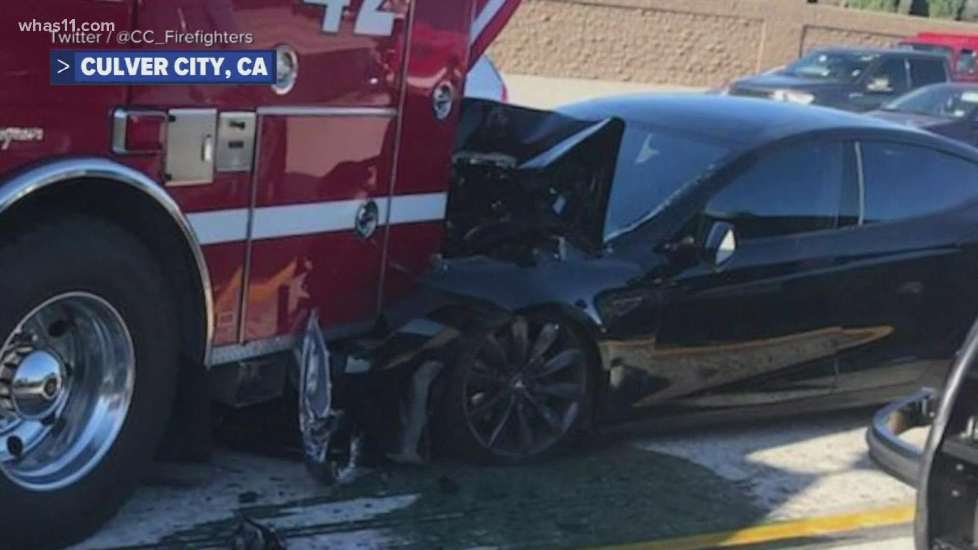
Autonomous Vehicles Edge-Cases: the risky reliance on real-world data
Cases
Tesla hitting Police Cars 10 times in three years - Stationary objects and flashing lights seemed to trick the A.I.[NY Times 2022]
US investigates Autopilot after 11 Teslas crashed into emergency vehicles [ArsTech 2021].
Safety regulator says automakers reported nearly 400 crashes of cars with automatic driver-assist [PBS 2022]
However - Over-optimism: “My guess as to when we would think it is safe for somebody to essentially fall asleep and wake up at their destination: probably toward the end of next year,” Elson Musk in 2019 [Ark 2019]
Current Mitigation: The Tesla engineers manually specified 221 triggers that are activated in their fleet [Karpathy 2021]. The models run in a "shadow mode", which works as a digital twin of the real system that allows to deal with disagreements between the camera and Lidar.
[NY Times 2022] Elon Musk’s Appetite for Destruction - https://www.nytimes.com/2023/01/17/magazine/tesla-autopilot-self-driving-elon-musk.html
[ArsTech 2021] https://arstechnica.com/cars/2021/08/us-investigates-autopilot-after-11-teslas-crashed-into-emergency-vehicles/
[PBS 2022] https://www.pbs.org/newshour/nation/u-s-safety-regulator-says-automakers-reported-nearly-400-crashes-of-cars-with-automatic-driver-assist
[Ark 2019] On the Road to Full Autonomy With Elon Musk - https://ark-invest.com/podcast/on-the-road-to-full-autonomy-with-elon-musk/
[Karpathy 2021] Closed AI Loop at Tesla for Labeling data that Trigger Corner Cases, Keynote at CVPR’21
Notes:
Let’s start with some edge-cases that still affect autonomous vehicles, for instance, Teslas colliding with emergency service trucks and police cars. The mitigation approach has been to collect continuously the data from cars, have the engineers analyze it, apply an auto-labelling tool, and finally incorporate the data to the training set. In other words, it is practically a closed loop engineering of an AI-system. That’s nice. So, what is wrong with this process? Besides possible ethical concerns with indiscriminate bulk data collection? We see at least two possible problems: first, critical data seem to be collected in an ad hoc and reactive manner; second, it is not clear which engineering principles are steering this process. For these reasons, it is difficult to measure success or provide safety and robustness guarantees to the AI-system.

Slide 4
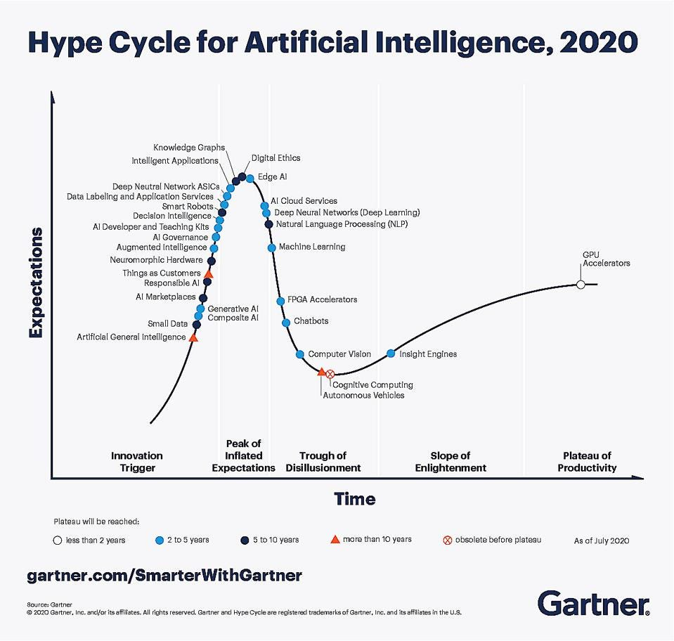
Meanwhile - AI systems are still not being successfully deployed
55% of companies surveyed haven't deployed a machine learning model [Algorithmia 2020]
72% that began AI pilots before 2019 haven’t deployed a single system yet [Capgemini 2020]
Why? Current models cannot adapt to more complex and evolving realities - adversarial environments
[Gartner 2020]
Problem? Lack of Robustness in AI Systems
[Jordan 2019], [D’Amour et al. 2020]
Notes:
-Meanwhile, in a broader perspective, industry surveys report that from 55 to 72% of companies are not being able to deploy AI systems.
-Why? Because these systems cannot adapt to more complex and evolving realities, in other words, adversarial environments.
-This inability to adapt is a problem of lack of robustness in these AI Systems.

Slide 5
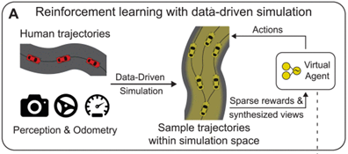
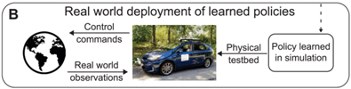
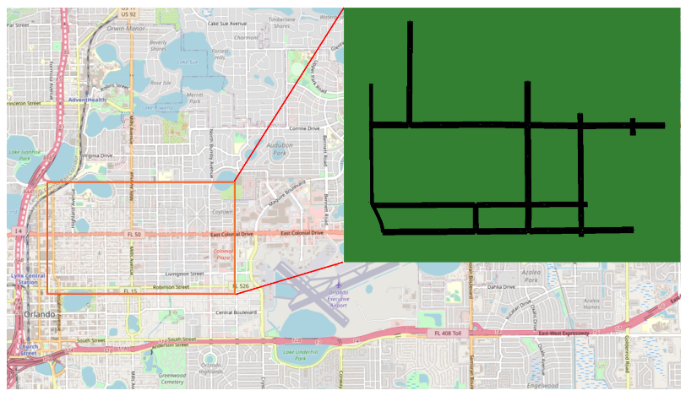
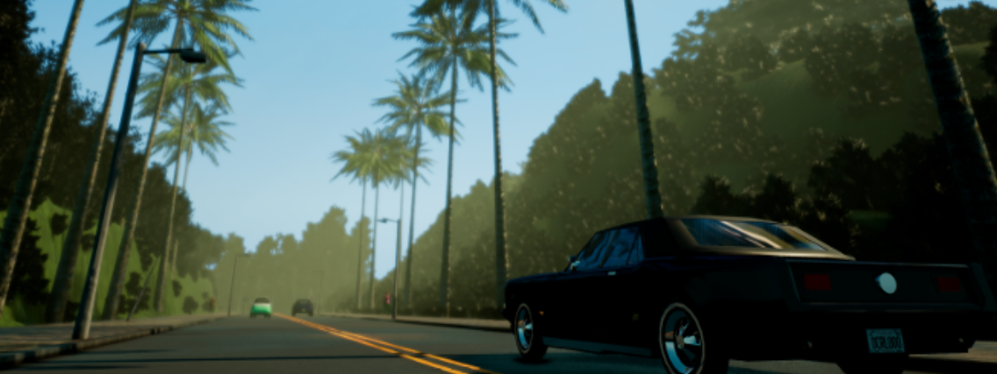
Reinforcement Learning for Autonomous Vehicle with Model-Based and Data-Driven Simulators
Learned policies not only transfer directly to the real world (B), but also outperform state-of-the-art end-to-end methods trained using imitation learning.
VISTA - From a single human collected trajectory the data-driven simulator synthesizes a space of new possible trajectories for learning virtual agent control policies (A). Preserving photorealism of the real world allows the virtual agent to move beyond imitation learning and instead explore the space using reinforcement learning with only sparse rewards.
CARLA has been developed from the ground up to support development, training, and validation of autonomous driving systems. In addition to open-source code and protocols, CARLA provides open digital assets (urban layouts, buildings, vehicles) that were created for this purpose and can be used freely. The platform supports flexible specification of sensor suites, environmental conditions, control of all static and dynamic actors, and map generation
Gym is an open source Python library developed by OpenAI and originally designed for developing and testing reinforcement learning algorithms.
SUMO-Gym is a portable, user-friendly AV simulation platform. Users of SUMO-Gym can test their AV pipeline to generate actions compatible with the package based on generic observations from SUMO-Gym
Notes:
Our insight is to look at principled ways to produce data for edge-cases and retrain models. For that we could leverage on generative methods and simulators, which can be model-based (like SUMO and Carla) or data-driven (like the MIT Vista).

Slide 6
Possible Architecture and its Realization
Safety & Robustness Models
Implementation Effort Expected
Autonomous Vehicle
Reinforcement Learning Agent
Communication
Coordination
Safety & Robustness - Design and Implementation for coping with the chosen (few) traffic edge-cases
Scaling
Agent’s policy Learning – Reuse out-of-the-box Stable Baselines API – no coding expected
State
Reward
Action
Gym Interface
Gym Interface as a wrapper of the Simulator API - a few lines of code expected
Simulator
(Carla,Vista,Sumo4AV)
Credit Assignment
Local and Global
Non-stationarity
Partial observability
Simulator - Reused out-of-the-box, no coding expected
Optional
Reuse out-of-the-box
Nguyen, et al. (2020). Deep reinforcement learning for multiagent systems: A review of challenges, solutions, and applications
Leibo, et al. (2017 ) "Multi-agent Reinforcement Learning in Sequential Social Dilemmas."
Notes:
One possible architecture would involve reusing three components out-of-the-box, from bottom-up: the simulator like Carla, Vista, or SUMO for autonomous vehicles, an interface to perform actions and collect rewards and states from the simulator (the Gym interface), and finally a reinforcement learning library, like Stable-Baselines. As an optional component, we could look at safety and robustness models for communication, coordination, and scalability of autonomous vehicles.

Slide 7
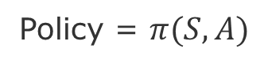
Agent Environment Interaction - Model-Based RL
Action
Environment
Agent
Environment
Environment (runtime model, representation)
Environment
(Simulator)
State
Reward
Agent’s Goal: Maximize its reward
Our Goal: Discover a strategy that allows the agent to achieve its goal under various circumstances
Search, Estimate, Learn
Policy = $π(S,A)$
knowlege about the environment

Slide 8
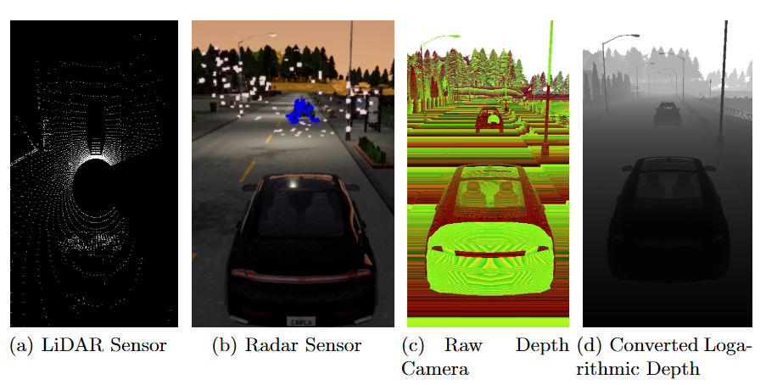
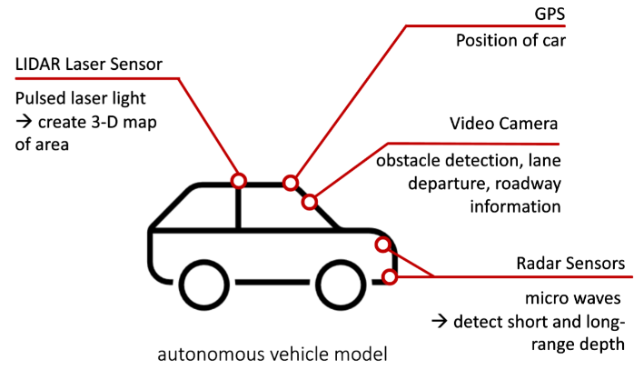
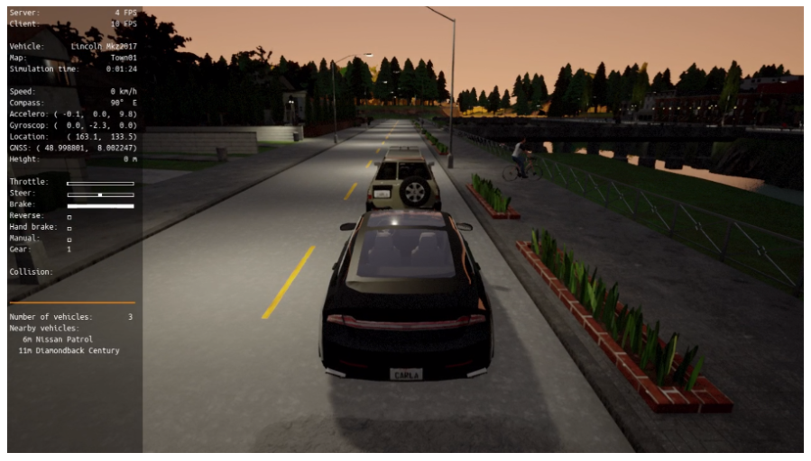
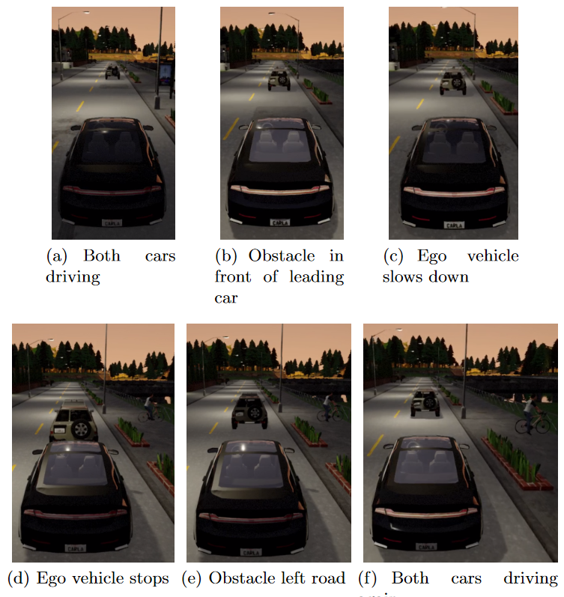
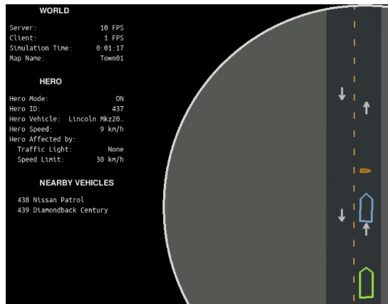
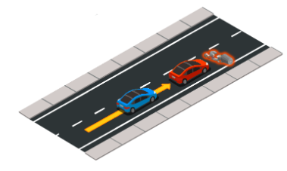
Example with Carla - developed during a previous project seminar [Terboven & Andree 2020]
Obstacle
Non-Rendering Mode
Carla Terboven and Kerstin Andree, 2020, Simulation of Autonomous Vehicles, Project Seminar Simulation, Summer Term 2020, Hasso-Plattner Institute, Uni-Potsdam.
Notes:
Here is an example of the capabilities of the Carla simulator, which generates various sensor data like camera, GPS, lidar, microwaves radar. The corresponding data of cars and obstacles can also be visualized in 3D and 2D rendering.

Slide 9
Roadmap and Deliverables
Equalize Team’s knowledge (seminars provided by our chair)
Learning Methods: Safe, Robust, Model-Based RL, Multi-Agent Models, Sim-2-Real
Evaluation Methods: Experimental Design, Robustness, Sensitivity Analysis, Transportability
Proof of Concept of Simulator (Deploy, Generate Scenarios & Edge Cases)
Ideate
Inception of Minimal Viable Product
Plan Iterations
Iterate
~ 2 week
~ 3 weeks
~ 2 week
~ 8 weeks
Deliverables
Technical Blog (lessons learned, how-to’s)
Presentation (seminar at our chair open to colleagues)
Technical report (publishable by HPI or submitted to conference/workshop)
Notes:
Our roadmap contemplates initial lectures to equalize the team’s knowledge on learning and evaluation methods. After that we will do a proof of concept on the simulator, which will give us the confidence to ideate a minimum viable product and corresponding iteration goals. As we progress, we will incrementally produce the deliverables, like technical blog, presentations, and a technical report, which we plan to submit to a conference or workshop.

Slide 10
Communication Plan & Organization
Coaching team – Chris, He, Prof. Giese
Weekly meetings – decision making, prioritization, brainstorming solutions
Monthly meetings - progress update
Motive | Content | Medium
Artifacts | Code, Data Documentation | Github, MiroBoard, GoogleDocs, Overleaf
Papers | Intelectual property | Zotero
Messaging ad hoc | Questions, Suggestions, Sharing | Slack
Official | Schedule, Orientations, Administrative issues | christian.adriano@hpi.de
Meetings | Lectures, Status, Work meetings | B-2.2 or Zoom
Emergency | Call, SMS, messaging | Chris mobile (check Slack profile)
Notes:
We have a structured communication plan that involves weekly and monthly meetings, and tools for paper sharing, artifact versioning, collaborative writing, and messaging.

Slide 11
References-Papers
[Algorithmia 2020] The State of Enterprise ML, https://info.algorithmia.com/hubfs/2019/Whitepapers/The-State-of-Enterprise-ML-2020/Algorithmia_2020_State_of_Enterprise_ML.pdf
[Capgemini 2020] The AI-Powered Enterprise, https://www.capgemini.com/gb-en/research/the-ai-powered-enterprise/
[Chen et al. 2021] Decision Transformer: Reinforcement Learning via Sequence Modeling, arXiv:2106.01345
[D’Amour et al. 2020] Underspecification presents challenges for credibility in modern machine learning, arXiv:2011.03395
[Leibo, et al. 2017] Multi-agent Reinforcement Learning in Sequential Social Dilemmas.
[Gartner 2020] https://www.forbes.com/sites/louiscolumbus/2020/10/04/whats-new-in-gartners-hype-cycle-for-ai-2020/?sh=723a6e57335c
[Janer et al. 2021] Janer, M., et al., Reinforcement learning as one big sequence modeling problem, arXiv:2106.02039
[Jordan 2019] Jordan, M., Artificial Intelligence, The Revolution Hasn’t Happened Ye, MIT Press
[Nguyen, et al. 2020] Deep reinforcement learning for multiagent systems: A review of challenges, solutions, and applications. IEEE transactions on cybernetics, 50(9), 3826-3839.
[Suton & Barto 2018] Reinforcement Learning, An Introduction, MIT Press
SUMO-Gym - Kusari, Arpan, et al. "Enhancing SUMO simulator for simulation-based testing and validation of autonomous vehicles." 2022 IEEE Intelligent Vehicles Symposium (IV). IEEE, 2022. - https://arxiv.org/pdf/2109.11620.pdf
CARLA - Open-source simulator for autonomous driving research - https://carla.org/
MIT VISTA 2.0 - Data-driven Simulation for Resilient and Sustainable Mobility - https://vista.csail.mit.edu/
Notes:
Here are some references relevant to the project. Thank you for your attention and please get in touch if would like to get more clarifications or exchange ideas. See you soon! Bye.
Principled Engineering + Causal Models
When the model performs better (whatever better means), can we reproduce it in similar contexts (whatever similar means)?
This requires forward and backward reasoning.
The forward reasoning is a set of principles that should be part of an engineering body of knowledge discipline.
The backward reasoning relies on explaining the outcomes via causal associations.

Slide 12
Risk management
Integration risks (simulators)
Performance risks (training)
Scope risks (features necessary for the paper)
Evaluation risks (threats to validity)
To Do: elicit probability, impact, mitigation plan

Slide 13
Execution plan
How are we going to work?
sprints for MVPs?
issue tracker as kanban?
progress in burn-down charts?
To Do: setup tools and first tasks

Slide 14
Comments on the Simulators
SUMO-Gym - Kusari, Arpan, et al. "Enhancing SUMO simulator for simulation-based testing and validation of autonomous vehicles." 2022 IEEE Intelligent Vehicles Symposium (IV). IEEE, 2022. - https://arxiv.org/pdf/2109.11620.pdf
Car following model - provide real-world like behavior of the background vehicles (BVs)
Intelligent Driver Model (IDM) - captures/estimates the driving patterns of individual driver
"SafetyPilot Model Deployment (SPMD) was a project undertaken by the U.S. Department of Transportation (USDOT) to evaluate the effectiveness of vehicle-to-vehicle communication technology (V2V) in safety applications“
Alternative: SUMO4AV - An Environment to Simulate Scenarios for Shared Autonomous Vehicle Fleets with SUMO - https://www.youtube.com/watch?v=YUcfahIY2iU
CARLA - Open-source simulator for autonomous driving research - https://carla.org/
Autonomous Driving sensor suite: users can configure diverse sensor suites including LIDARs, multiple cameras, depth sensors and GPS
Fast simulation for planning and control: this mode disables rendering to offer a fast execution of traffic simulation and road behaviors for which graphics are not required.
Maps generation: users can easily create their own maps following the OpenDrive standard via tools like RoadRunner.
Traffic scenarios simulation: our engine ScenarioRunner allows users to define and execute different traffic situations based on modular behaviors.
MIT VISTA 2.0 - Data-driven Simulation for Resilient and Sustainable Mobility - https://vista.csail.mit.edu/
Photo realistic simulation
Various types of weather and geographic conditions
Perception suites

Slide 15
Next Tasks
Risk management plan
Setup environment (GitHub, Zotero, Slack, GoogleDocs, Overleaf)
Prepare overview of Model-based RL and Evaluation methods
Study Simulators
SUMOGYM + SUMO4AV -> Person-1
MIT Vista -> Person-2
SUMO + Carla-> Person-3
Chris
Next Meetings:
Monday May 1st ->Thursday April 27th ?
Thursday May 4th ->(just sent you a Doodle)
Monday May 8th 17h

Slide 16
END

